Slide 1
Webpage Aesthetics Rating with Deep Learning
17 Aug 2016

Slide 2


Background
Webpage aesthetics are a decisive factor for engaging users online.

Slide 3
Background
How to estimate a good design of a webpage?
- complexity
- color scheme
- balancing
- texture
- …
Implicitly, subjective, background dependent, …
Let computer learn to automatically estimate
webpage aesthetics from big data
Identify and quantify key image features that are
predictive of favorable aesthetic judgements by
most individuals

Slide 4
Related Works
Webpage aesthetics rating with hand-crafted features from color, context, space layout
- Correlating low-level image statistics with
users’ rapid aesthetics and affective judgments
of webpages (Zheng et al. CHI’09)
- Predicting users’ first impression of website
aesthetics with a quantification of perceived visual
complexity and colorfulness (Reinecke et al. CHI’13)

Slide 5
Related Works
Photo aesthetics rating with deep learning features from convolutional neural networks
- Deep multi-patch aggregation network for image
style, aesthetics, and quality estimation
(Lu et al. ICCV’15)
- Photo aesthetics ranking networks with attributes
and content adaptation (Kong et al. ECCV’17)

Slide 6

Related Works
Photo aesthetics rating with deep learning features from convolutional neural networks
Low quality
High quality
Lu et al. ICCV’15

Slide 7



Method
Deep Neural Networks
- learn webpage aesthetics from big data
- rate new webpages automatically
CNN
Rating

Slide 8
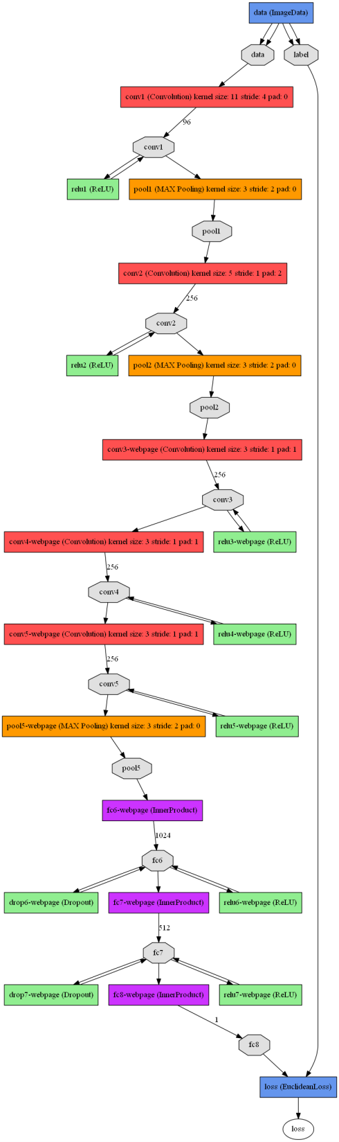
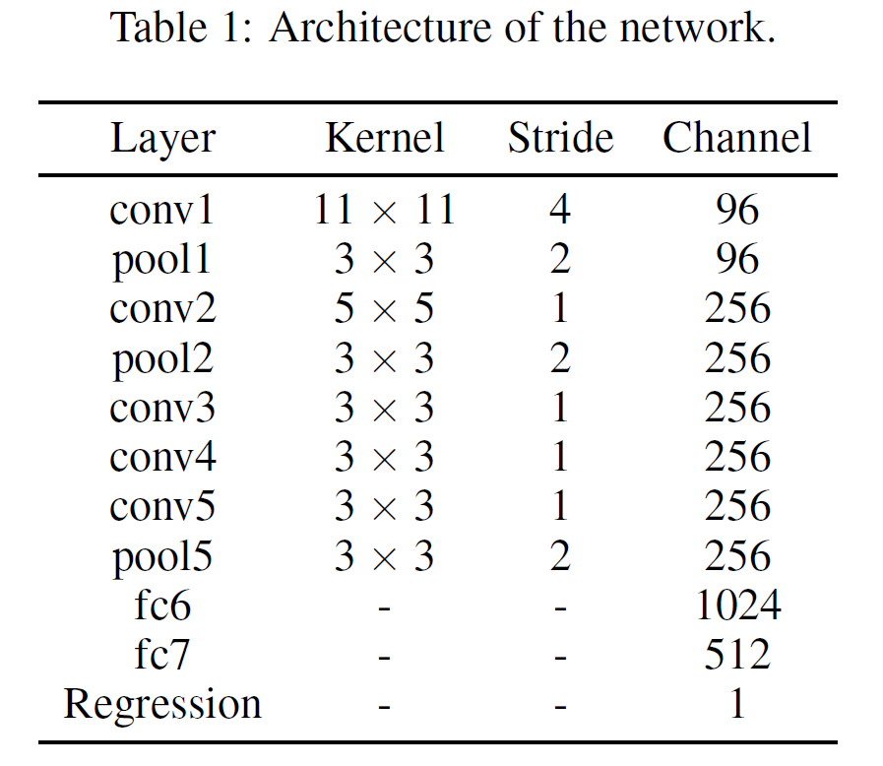
Method
Deep Neural Networks
- 11-layer convolutional neural networks

Slide 9
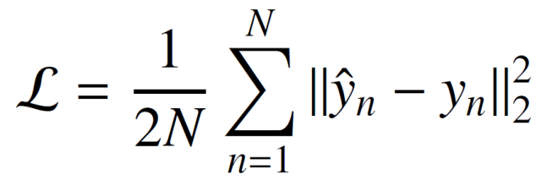
Method
Deep Neural Networks
- 11-layer convolutional neural networks
- regression to an output rating
- minimize Euclidean distance
- stochastic gradient descent to update
weights in optimization

Slide 10
Method
Linear regression (baseline comparison)
- hand-crafted complexity and colorfulness

Slide 11
Experiment
Dataset
- 398 webpages (languages of English and Foreign)
- 300 training (75.4%), 38 validation (9.5%),
60 testing(15%)
- Users rating from 40000 people, averagely each
webpage received 1000 ratings

Slide 12
Experiment
Network Training
- fine-tune CaffeNet pre-trained on Flickr dataset for
image style recognition
- initialize the first two convolutional layers
Sampling Strategy
- use average rating from users (overfitting)
- use all ratings from users (too much noise)
- remove rating outliers (bias)
- randomly sample user ratings

Slide 13
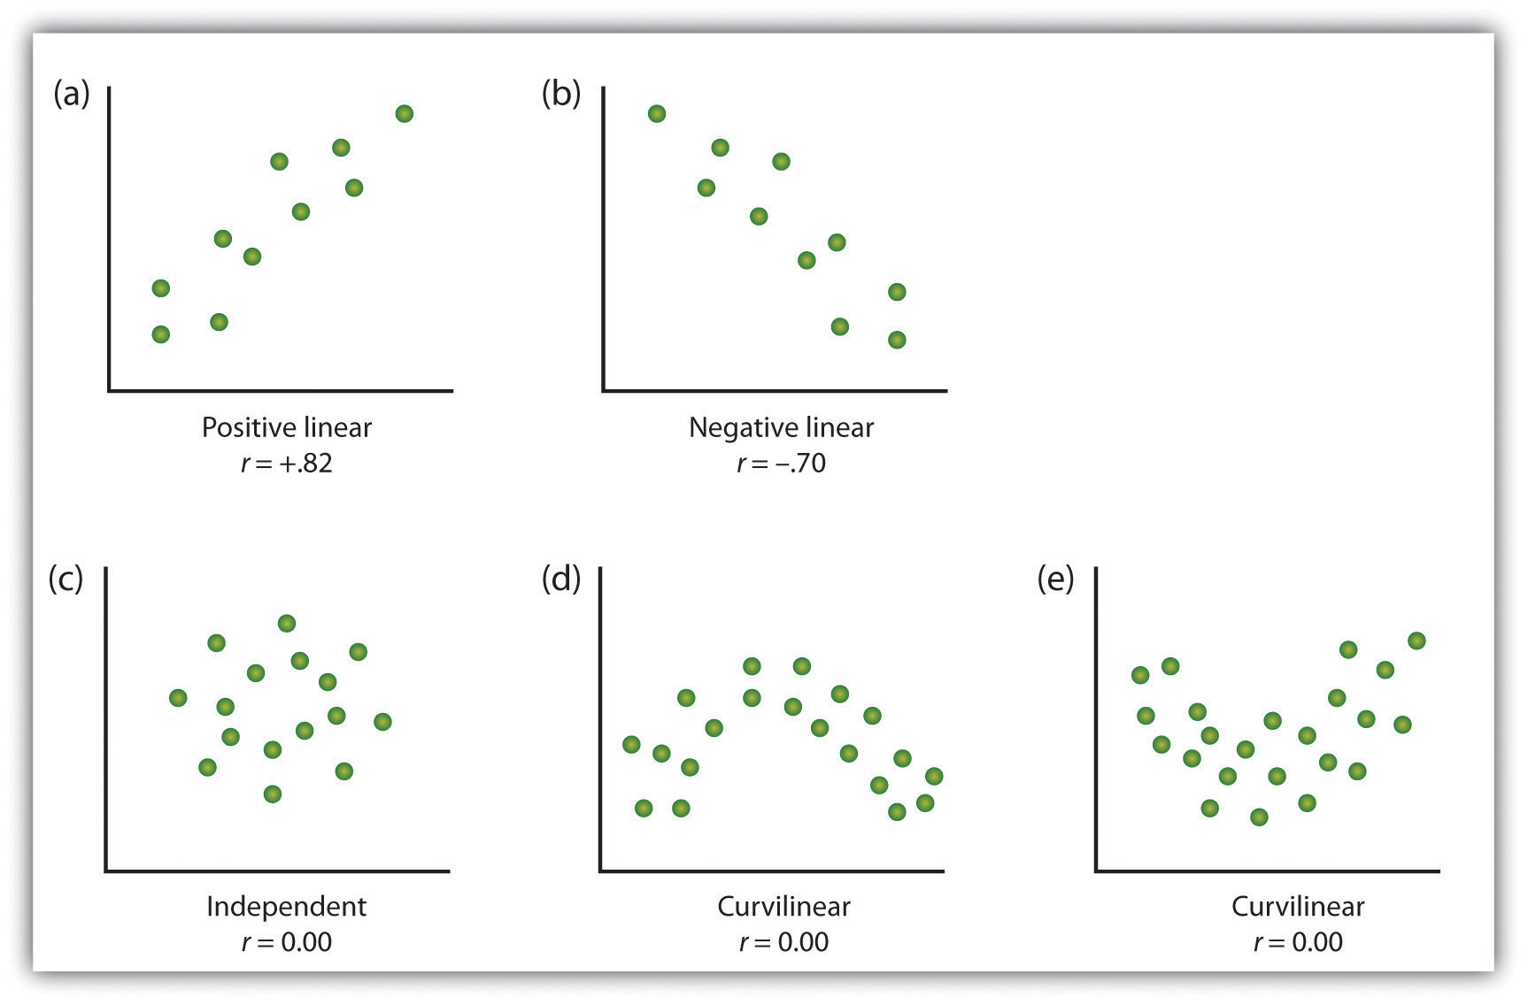
Results
Quantitative Evaluation metric
- Pearson correlation r: measurement of the linear
relationship between our prediction results and
users’ ratings.

Slide 14
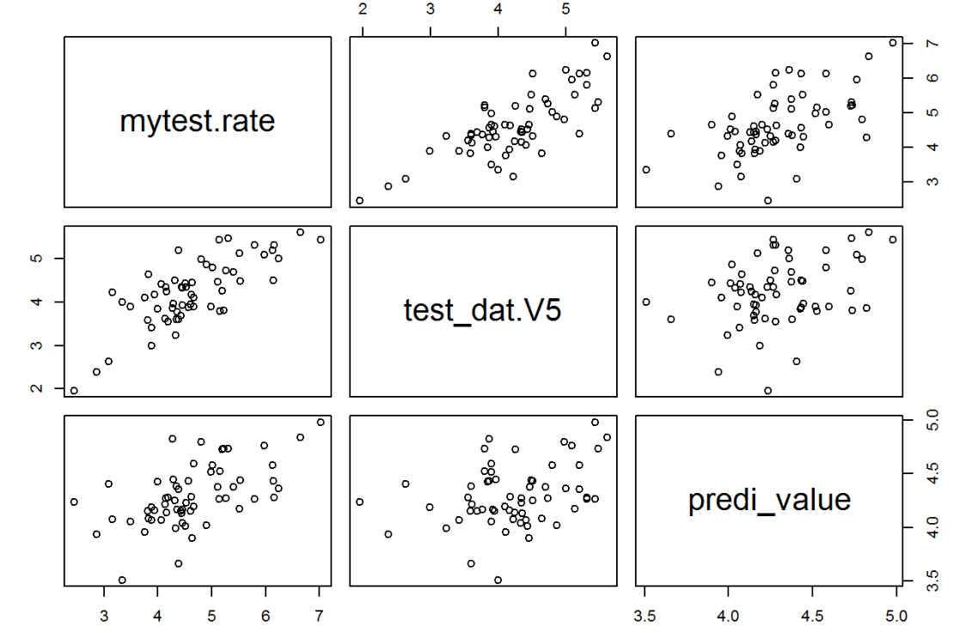
Results
Scatter plots of prediction results
CNN
Ground Truth
r = 0.76
p < 0.001
Linear Regression
r = 0.57
p < 0.001

Slide 15

Results
Examples of webpage rating prediction
Users’ rating: 4.44
CNN prediction: 4.35
Linear Regression: 4.13

Slide 16
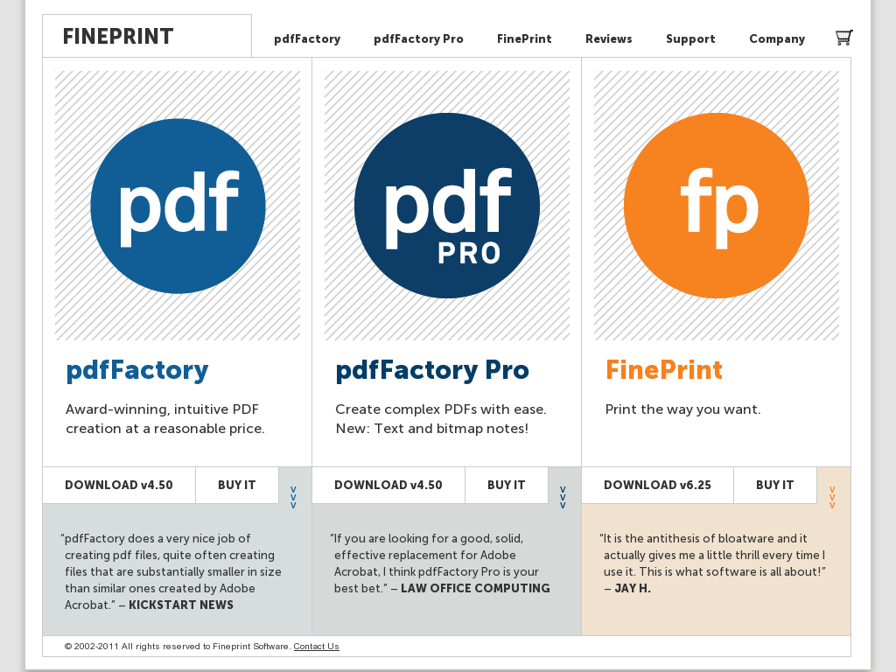
Results
Examples of webpage rating prediction
Users’ rating: 5.14
CNN prediction: 4.43
Linear Regression: 4.26

Slide 17

Results
Examples of webpage rating prediction
Users’ rating: 7.03
CNN prediction: 5.43
Linear Regression: 4.98

Slide 18
Thank you

